Slide 1
Engineering Requirement Software project of online books borrow(OBB)
Students Preparation:
Feras Sameer Saleem
Mohammed Ghasan Alqunbar
Osaid Abdalqader Daghash
Doctor:
Ahmed Bani Mustafa

Slide 2

Vision Document
The vision of the online book borrowing system is to provide a platform for users to browse, search, and borrow books online, from the comfort of their homes or any location with internet access. The system will allow registered users to borrow books for a limited period of time, renew their loans, and return the books through a convenient process. The system will also provide an easy way for administrators to manage the book inventory, user accounts, and loan requests.

Slide 3
SRS Document
2.1 Functional Requirements
2.2 Functional Non-Requirements
2.3 Glossary

Slide 4
2.1 Functional Requirements
User Registration: Users should be able to register for a new account by providing their personal details, including name, address, email, and contact number.
Book Search: Users should be able to search for books based on various criteria, including title, author, and category.
Book Reservation: Users should be able to reserve a book if it is currently unavailable, and they will be notified when the book becomes available.
Loan Request: Users should be able to request a book loan for a specific period, and the loan request should be approved or rejected by the system administrator.
Loan Renewal: Users should be able to renew their book loans for an additional period, subject to approval by the system administrator.
Return Book: Users should be able to return books through a convenient process, including online or in-person return.
Admin Dashboard: Administrators should be able to view and manage the book inventory, user accounts, and loan requests.
Book Addition: Administrators should be able to add new books to the system and update book details, including title, author, category, and availability status.

Slide 5
2.2 Functional Non-Requirements
Security: The system should ensure the confidentiality and integrity of user data and protect against unauthorized access.
Performance: The system should be able to handle a large number of concurrent users and provide fast response times.
Scalability: The system should be able to scale up or down based on changing user demands.
Accessibility: The system should be accessible to users with disabilities, including support for screen readers and keyboard-only navigation.

Slide 6
2.3 Glossary
User: A person who registers and uses the online book borrowing system.
Administrator: A person who manages the book inventory, user accounts, and loan requests.
Book: A physical or digital item that can be borrowed by users.
Loan: A period of time during which a user can borrow a book.
Reservation: A request to hold a book for a user until it becomes available.

Slide 7
Use Case Model
4.1 Use Case Diagram
4.2 Use Case Descriptions

Slide 8
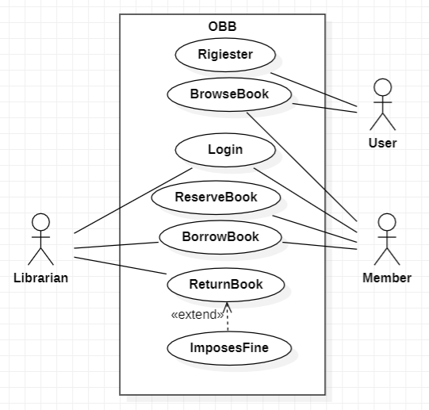
4.1 Use Case Diagram
Online Book Borrowing System Use Case Diagram

Slide 9
4.2 Use Case Descriptions
BorrowBooks | Use case name
Librarian, Member | Participating actors
The Librarian is logged into OBB | Precondition
The librarian opens the web page The librarian login on the web page The member approaches the librarian with the book they wish to borrow. The librarian checks the availability of the book in the library's stock. If the book is available: a. The librarian records the loan by associating the book with the member. b. The librarian issues the book to the member. The loan period starts from the current date for a maximum period of two weeks | Flow of events
Member take a Book | Postcondition
Return the book at the time of delivery | Quality requirements

Slide 10
Use-Case Description
ReserveBooks | Use case name
Member | Participating actors
The Member is logged into OBB | Precondition
Open the web page Browse available books Login Click on the selected book Click on the Reserve button | Flow of events
Send notice of book information | Postcondition
Choose the right book and Reserve it | Quality requirements

Slide 11
Login | Use case name
Member, Librarian | Participating actors
Open the Web Site | Precondition
Member Open the Web Site Member login to OBB Member Write a username Member Write a password The system checks if the username and password are correct If correct, log in If wrong, a notification is sent to re-type the name or password2. Librarian Open the Web Site Librarian Open the Web Site Librarian login to OBB Librarian Write a username Librarian Write a password The system checks if the username and password are correct If correct, log in If wrong, a notification is sent to re-type the name or password2. Librarian Open the Web Site | Flow of events
Logged in OBB | Postcondition
Facilitate the borrowing process Find the required books without wasting time | Quality requirements

Slide 12
Analysis Model
For the Loan Request use case, the analysis model would include the following analysis classes:
User: The person who requests a loan.
Book: The item being borrowed.
Loan Request: The request made by the user to borrow a book, including the loan period and other details.
Loan History: The history of all previous loans made by a user, including the loan request, loan period

Slide 13
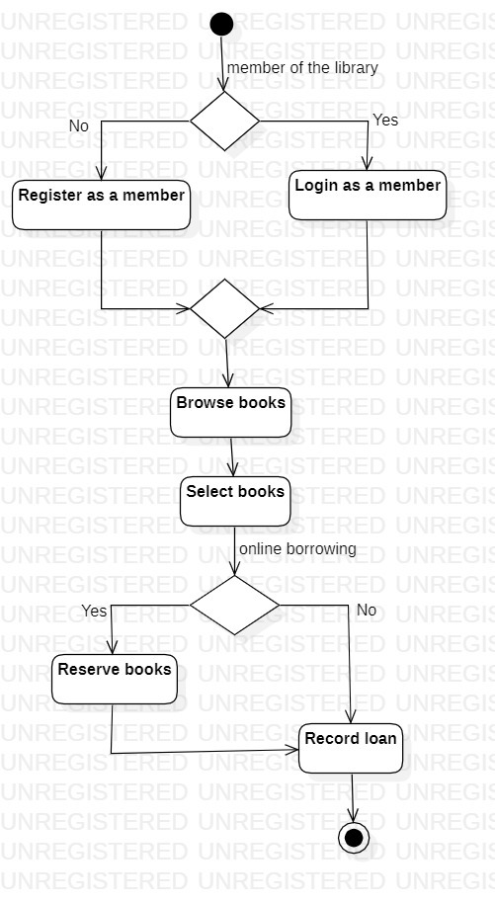
Activity Diagrams

